Slide 1

ROUTE OPTIMIZATION
SUBMITTED BY:
TEAM 3B
Seerat Chhabra
Mahindra Venkat Lukka
Chris Chou
YC Wang

Slide 2
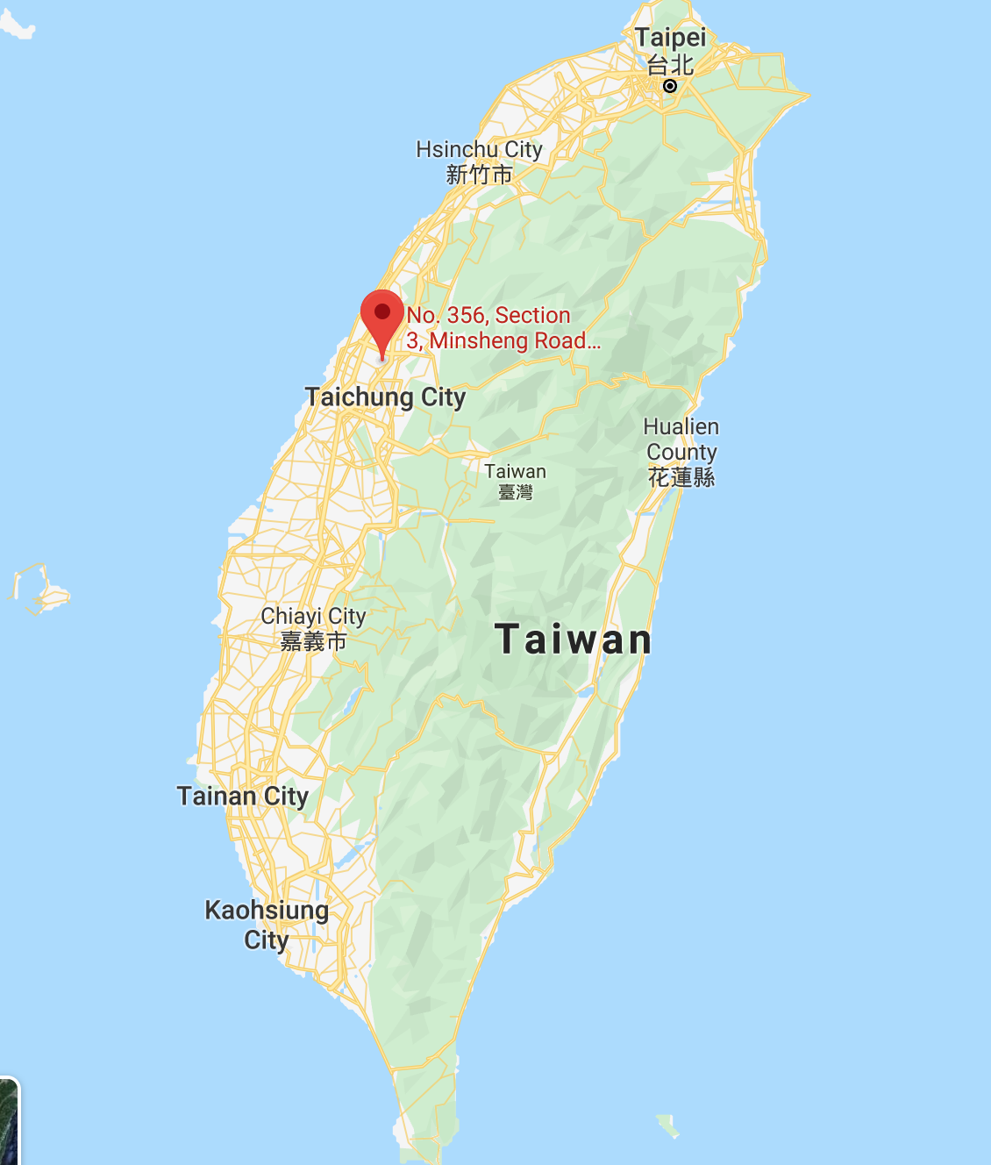
About company – HERO OF LIQUOR
Hero of liquor (HOL) – Family business owned by parents of Hsin –Ting (Our Classmate)
Wholesale liquor, wine and alcohol distributor located in Taichung, Taiwan
Customers within 3 regions – North, Middle and South

Slide 3
Important figures about company
Region | # of retailers | Demand per day (# of boxes)
North | 21 | 120
Middle | 14 | 80
South | 14 | 80
Total trucks = 7
Starting and ending point – Same for all trucks
Each Truck Capacity – 40 boxes

Slide 4

Optimal trucks routing using genetic algorithm

Slide 5
Input parameters
Distance matrix
Demand per retailer

Slide 6
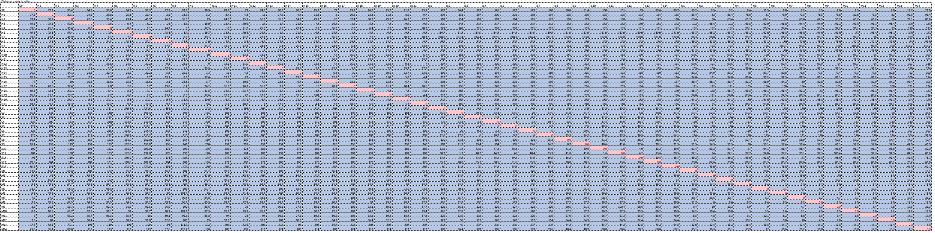
Distance matrix (50*50)

Slide 7
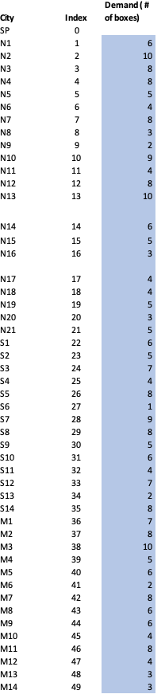
Demand per retailer

Slide 8
Mathematical model
Input parameters:
D_{ij} = Distance matrix with distance in miles from retailer location i to retailer location j where i, j ε [ 0,1,2, …… 49] where 0 is Starting point and 1-49 are the 49 retailer locations
S_{i} = Products required by retailer i on a certain day where i ε [ 1,2, …… 49] where 1-49 are the 49 retailer locations
M = Maximum capacity of truck
Decision Variable:
X_{km} = Which city to visit in step k and for truck m where k ε [ 1,2, …7] and m ε [ 1,2, …7] as each truck can visit to 7 locations and there are 7 trucks

Slide 9
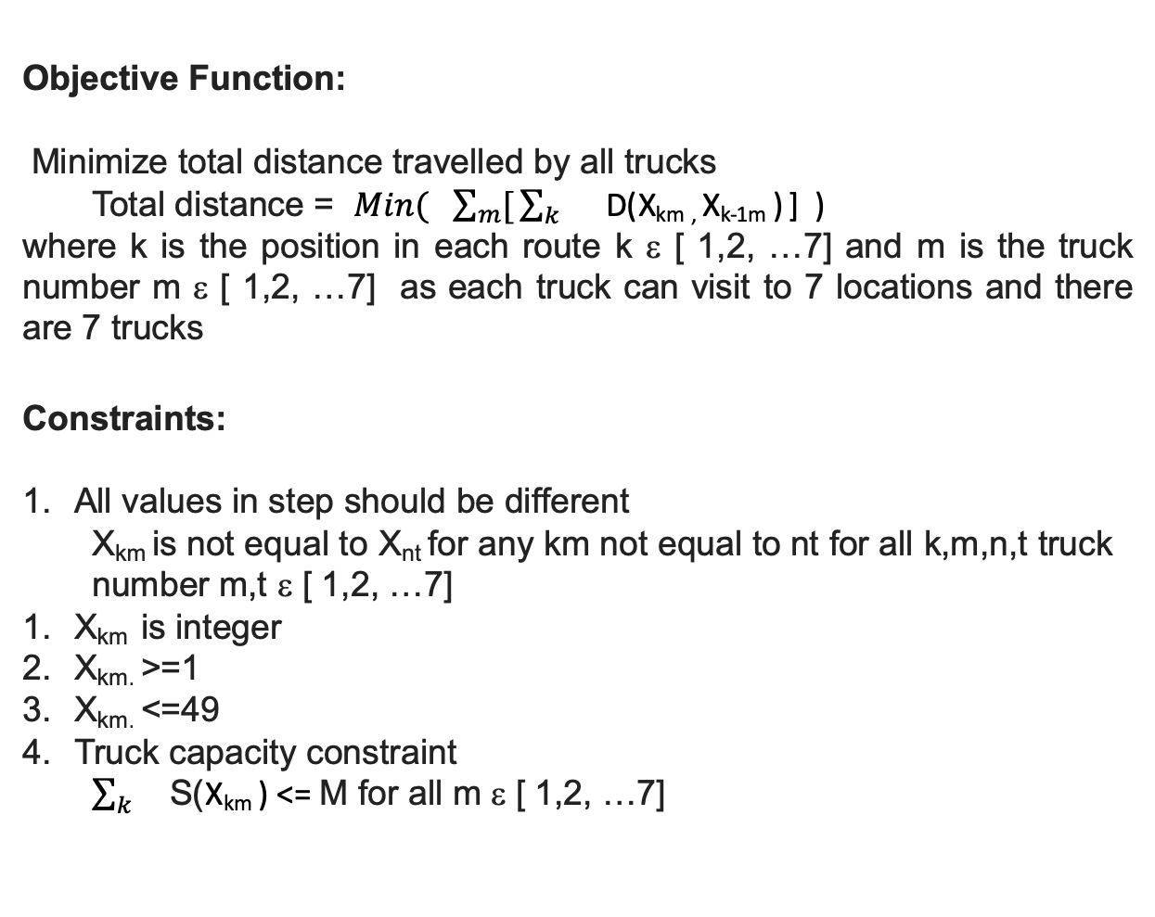
Mathematical model
Objective Function:
Minimize total distance travelled by all trucks
Total distance = $Min( \sum_{m}{[}\sum_{k}{}$ D(X_{km ,} X_{k-1m} ) ] )
where k is the position in each route k ε [ 1,2, …7] and m is the truck number m ε [ 1,2, …7] as each truck can visit to 7 locations and there are 7 trucks
Constraints:
All values in step should be different
X_{km} is not equal to X_{nt} for any km not equal to nt for all k,m,n,t truck number m,t ε [ 1,2, …7]
X_{km} is integer
X_{km.} >=1
X_{km.} <=49
Truck capacity constraint
$\sum_{k}{}$S(X_{km} ) <= M for all m ε [ 1,2, …7]

Slide 10
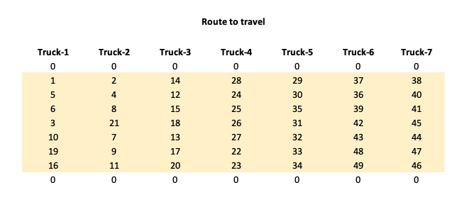
DECISION VARIABLE
Step 1
Step 2
Step 3
Step 4
Step 5
Step 6
Step 7

Slide 11
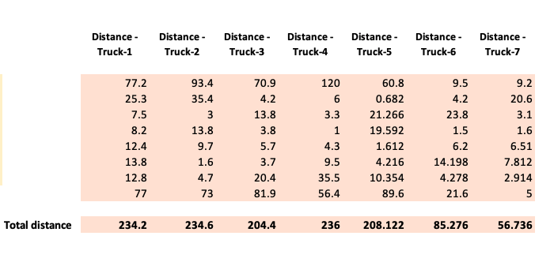
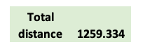
OBJECTIVE FUNCTION
Step 1
Step 2
Step 3
Step 4
Step 5
Step 6
Step 7
MINIMIZE

Slide 12
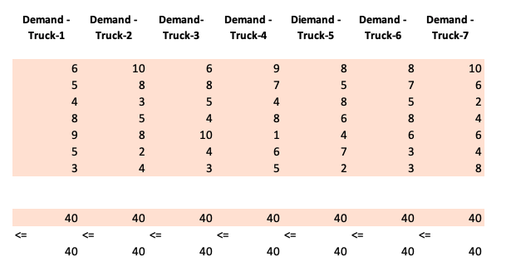
CONSTRAINTS
1
2
Truck capacity
All different

Slide 13
result
NORTH
SOUTH
MIDDLE

Slide 14
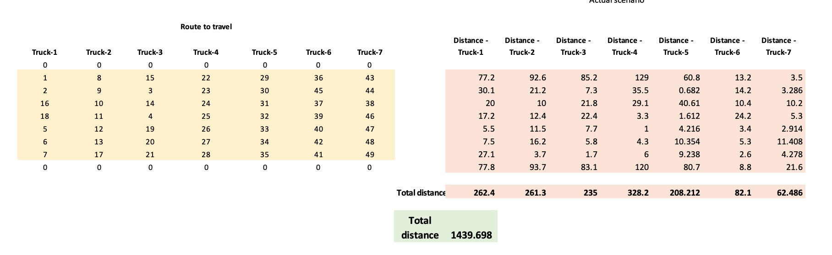
Company’s Current route plan

Slide 15
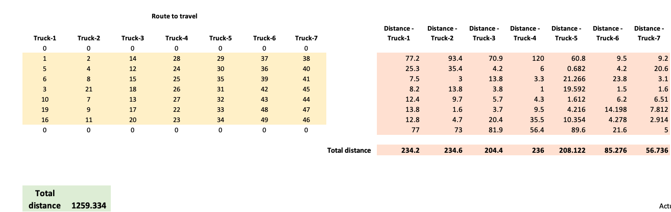
Optimized route plan
decreased DISTANCE

Slide 16
Current route FOR TRUCK7 – before optimization
Total distance –62.5 miles

Slide 17
Optimized route FOR TRUCK7 savings in distance per day – 5.75 MILES
Total distance – 56.7miles

Slide 18
Current route FOR TRUCK4 – before optimization
Total distance –328.2 miles

Slide 19
Current route FOR TRUCK4 – after optimization savings in distance per day – 92.2 MILES
Total distance –236 miles

Slide 20

Total savings in distance travelled per day – 180.36 miles ~$11,650 per year

Slide 21

Questions?

Slide 22

Thank you!

